Slide 1

C# OOP Advanced
Course Introduction
SoftUni Team
Technical Trainers
Software University
https://softuni.bg/

Slide 2
Table of Contents
Course Objectives
Training and Team
Course Organization
Course Infrastructure
Evaluation Criteria

Slide 3
Have a Question?
sli.do
#fund-csharp

Slide 4

Course Objectives

Slide 5
Course Objectives
Apply good practices for building quality software
SOLID Principles
Obtain type information at runtime
Create Custom DI Framework
Ensure a software application does what its authors intend it to do with automated testing
Use NUnit framework

Slide 6
Practical Exam
1 practical problem for 6 hours:
You are given a partially-implemented C# project
You should implement the rest of it and fix any bugs
Use Reflection inside the project
Write Unit Tests for the project
Automated judge system with real-time feedback
Upload a zip project to the judge system

Slide 7
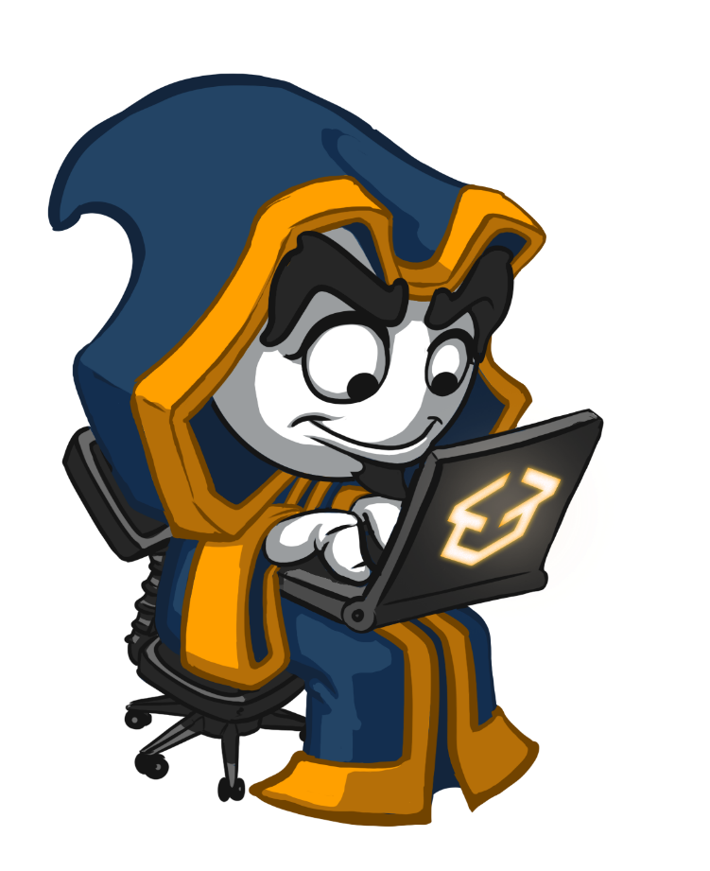
Exam Demonstration

Slide 8

The Team

Slide 9
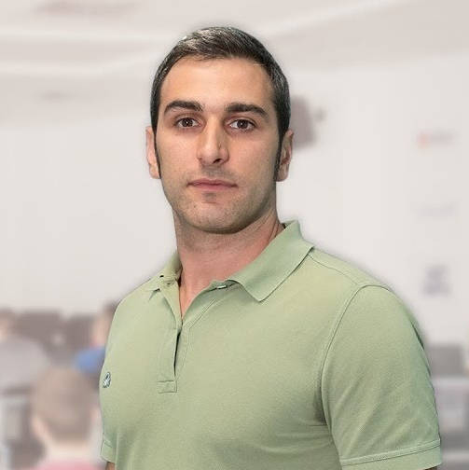

Radi Atanasov
Chief SharePoint Architect, Owner @ OneBit Software
Achieved two of highest degrees of technologie certification
Microsoft Certified Master
Microsoft Certified Solution Master
External consultant at "Office 365 Developer Patterns & Practices Core Team" at Microsoft Redmond

Slide 10
ONEBIT SOFTWARE
Software development and consulting company
Heavy involvement with the Microsoft SharePoint platform
Winning and delivering some of the best SharePoint projects
OneBit Survey Master
OneBit Quick Poll
https://www.onebitsoftware.net/

Slide 11
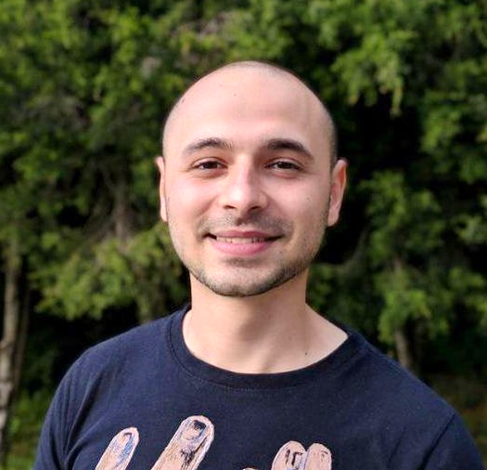
Stoyan Shopov
Technical Trainer @ SoftUni
ASP.NET Web Developer
Experience with MSSQL and ADO.NET
Interested in self-development and business
Mountain lover

Slide 12

Course Organization

Slide 13
Course Information
4 weeks / 4 times a week
12 Credits
Time frame
19-Nov-2018 – 16-Dec-2018
Exam
16-Dec-2018 16:00
Retake
21-Dec-2018 09:00

Slide 14

Homework Assignments & Exercises
Your homework is mainly work in class
Lesson days → slides + live demos + exercises
Exercise days → only exercises
How to submit your homework?
Submitted in the judge system
Do your homework when it's due
Assignments pile up quickly

Slide 15


Scoring System for the Course
Mandatory:
Final exam – 85%
Exercises & homework – 15%
Bonuses:
Presence in class – 5% bonus
Forum activity – bonus up to 5%

Slide 16



Course Web Site, Forum and FB Group
Official web site:
Official discussion forum:
Official Facebook group:
https://softuni.bg/courses/csharp-oop-advanced
softuni.bg/forum/categories/15/
http://fb.com/groups/ SoftUniCsharpFundamentalsSeptember2018

Slide 17
https://softuni.bg/courses/csharp-oop-basics

Slide 18













SoftUni Diamond Partners

Slide 19




SoftUni Organizational Partners

Slide 20




Trainings @ Software University (SoftUni)
Software University – High-Quality Education and Employment Opportunities
softuni.bg
Software University Foundation
http://softuni.foundation/
Software University @ Facebook
facebook.com/SoftwareUniversity
Software University Forums
forum.softuni.bg

Slide 21

License
This course (slides, examples, demos, videos, homework, etc.) is licensed under the "Creative Commons Attribution-NonCommercial-ShareAlike 4.0 International" license

